Slide 1
GEOG788P Project Final Presentation
Guimin Zhu
December 7, 2020

Slide 2
Content
1. Research questions
2. Data
3. Methods
4. Results
5. Discussion and conclusion

Slide 3
1. Research questions
1.1. Background
The US is facing a severe COVID-19 situation, with over 14.8M COVID-19 cases and over 282K deaths across the US, while the numbers for Maryland are 215K and 4,846, respectively.
Living in Maryland, the public is interested in how the COVID-19 pandemic has evolved in Maryland, how Maryland Department of Health reacted and mitigated the pandemic, when the second/third wave would come, etc.

Slide 4
1.2. Objectives of study
Question 1: What are the spatiotemporal patterns of COVID-19 pandemic in Maryland in terms of positive cases? Where are the hot spots/cold spots?
Question 2: What are the demographic and socioeconomic determinants that are impacting COVID-19 outbreak? How did these factors change over the 2 time periods (03/15-06/30 and 07/01-08/31)?

Slide 5
2. Data
Data | Description | Source
COVID-19 related data | Cases by county, age, gender, race and ethnicity & cases by zip code | Maryland Department of Health
Maryland boundaries | County level, zip code level, and census tract level | Maryland’s Open Data Portal and Maryland’s GIS Data Catalog
Maryland statistics | Populations, age, gender, race/ethnicity, income and poverty, housing, education, and employment | 2018 ACS
Maryland hospital locations | Hospitals licensed by Maryland DOH | Maryland’s GIS Data Catalog

Slide 6
3. Methods
3.1. Process and geo-visualize data
Visualized COVID-19 cases trend at zip code level for 2 time periods (03/15-06/30 and 07/01-08/31). What is the overall trend of Maryland COVID-19 cases? Which county has the most case number? An animated visualization is provided.
Cross walked the case data from zip code level to census tract level. The explanatory variables selected for spatial modelling are:
Population density, race/ethnicity (White, Black, Asian, Native, Other), age groups (0-19, 20-39, 40-59, 60-79, 80+), population with bachelor degree or higher, population below poverty level, median household income, unemployment rate, uninsured population
The dependent variable is new COVID-19 positive cases in 03/15-06/30 and 07/01-08/31

Slide 7
3.2. Spatial clustering
Performed hotspot analysis using Local Moran’s I to identify the clusters of COVID-19 cases. Regionalization using K-Nearest Neighbor (k=5, 4 nearest neighbors) failed (needs further study).
3.3. Run OLS and Random Forest models
Standardized the dataset for OLS regression. Compared the coefficients of top impacting features of the 2 models. Filtered out extreme records, train (75%) test (75%) split with 5-fold cross-validation, tuned hyperparameters, solving overfitting using regularization/oversampling techniques/stratify splitting/etc.

Slide 8
3.4. Geographically Weighted Regression
Performed GWR using top features obtained from Random Forest models. Compared surfaces of parameters.

Slide 9
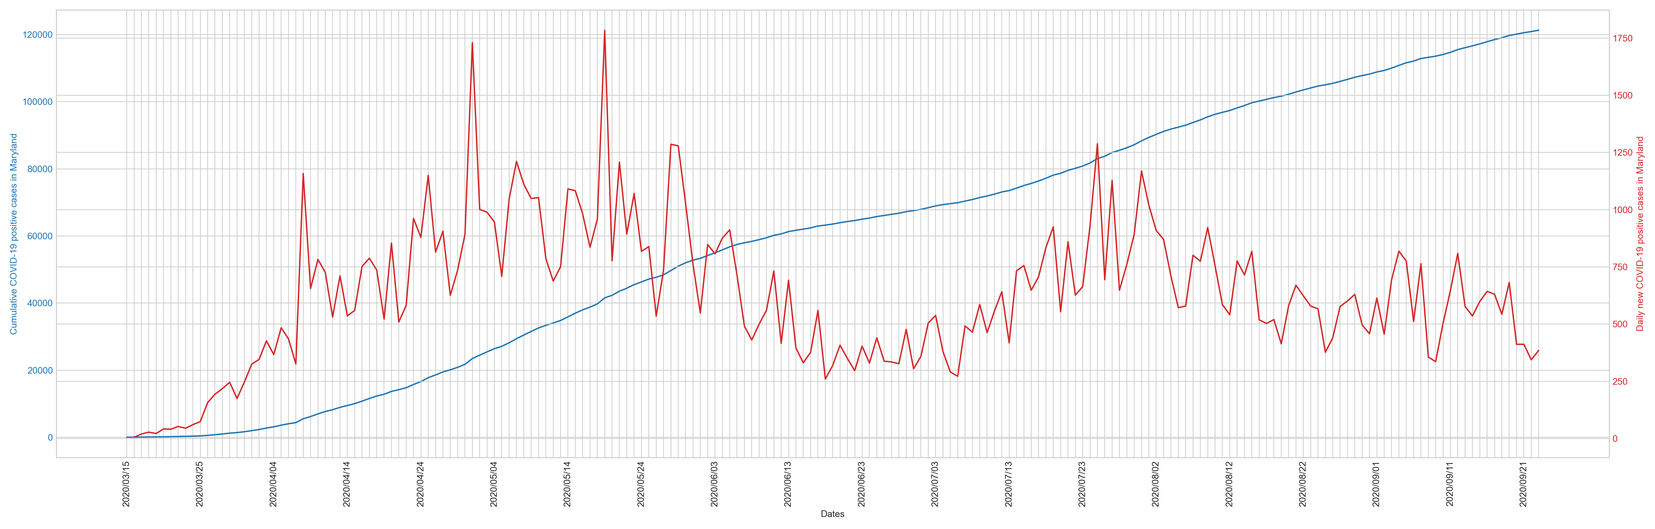
4. Results
4.1. COVID-19 trends
Maryland cumulative COVID-19 positive cases (blue) and daily new cases(red), 03/15 – 08/31
Notes:
Cases: the flat curve during the mid-June to mid-July period indicates low increases, but after that, the situation seems to be getting worse. The August period seems to be the second wave (and we are currently in the third wave).

Slide 10
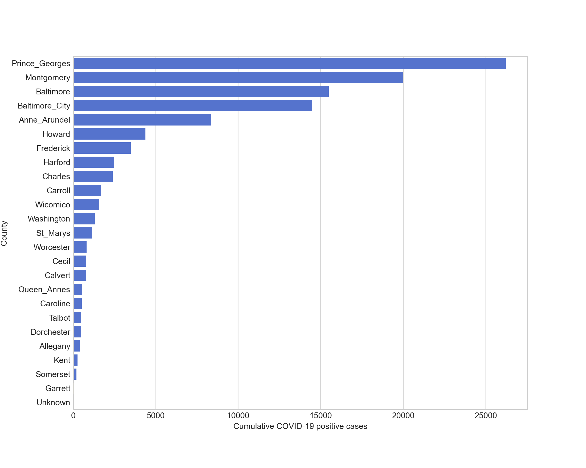
Maryland cumulative COVID-19 positive cases rankings by county (as of 08/31)
Notes:
Prince George’s county, Montgomery county, and Baltimore area have most of the cases.

Slide 11
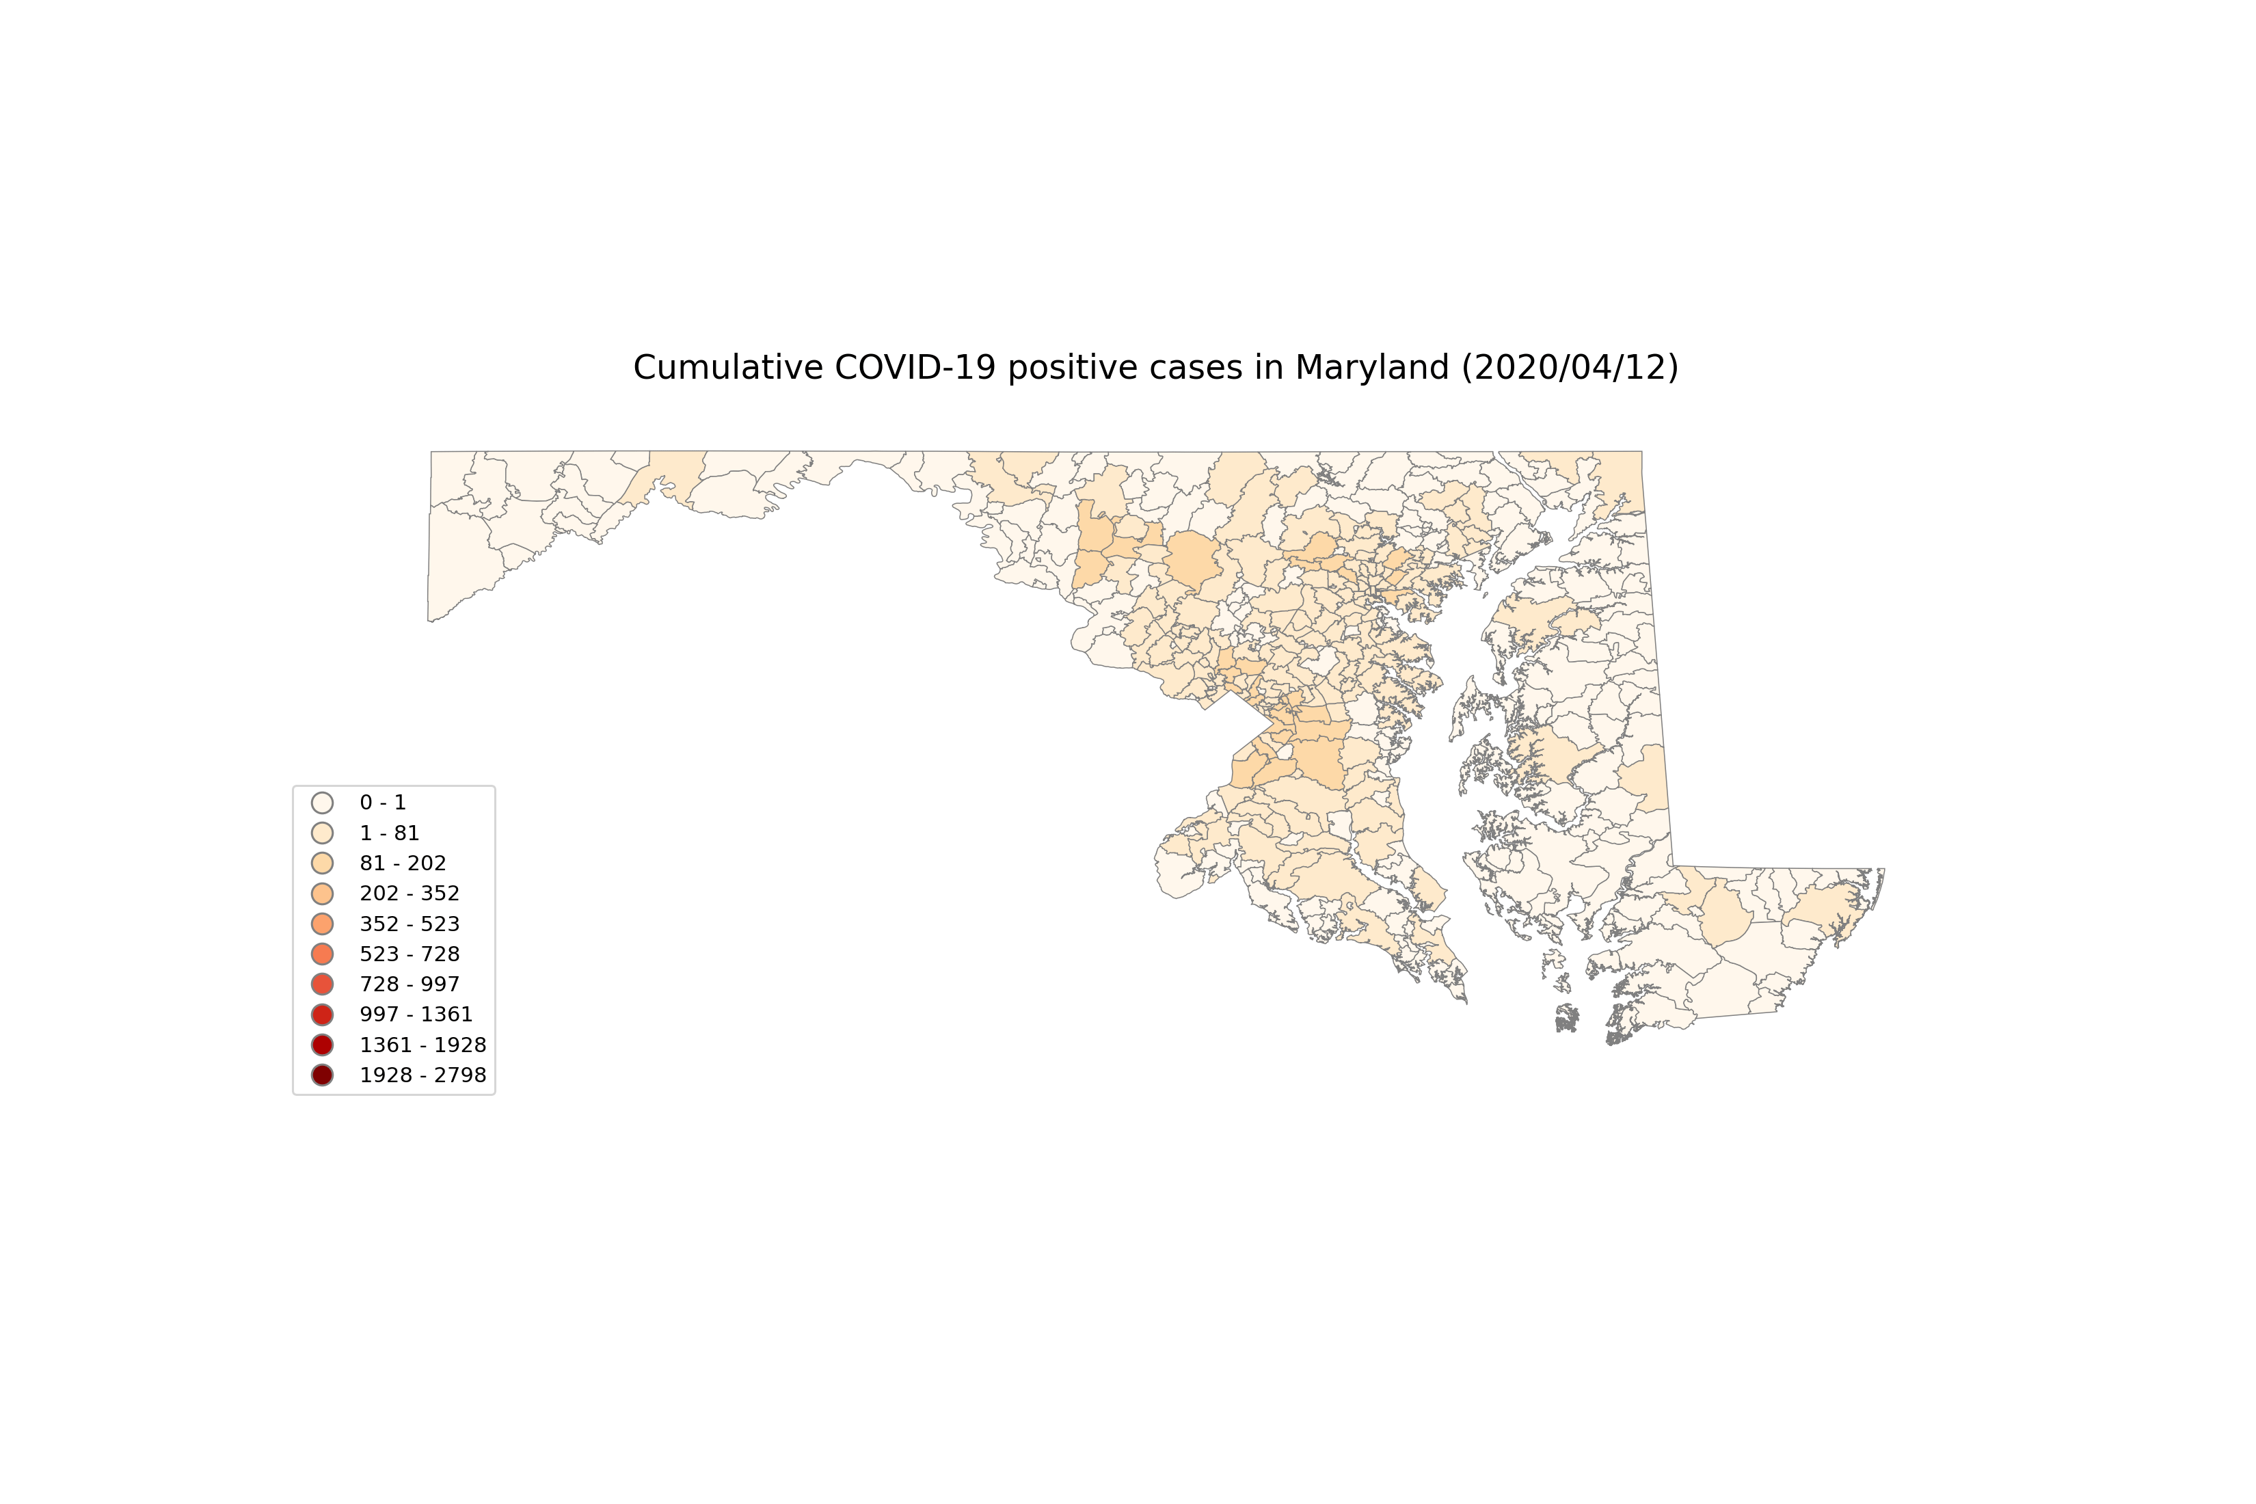
Notes:
An animation of how the cases at zip code level evolved, starting from 04/12 and using 14 days as intervals.

Slide 12
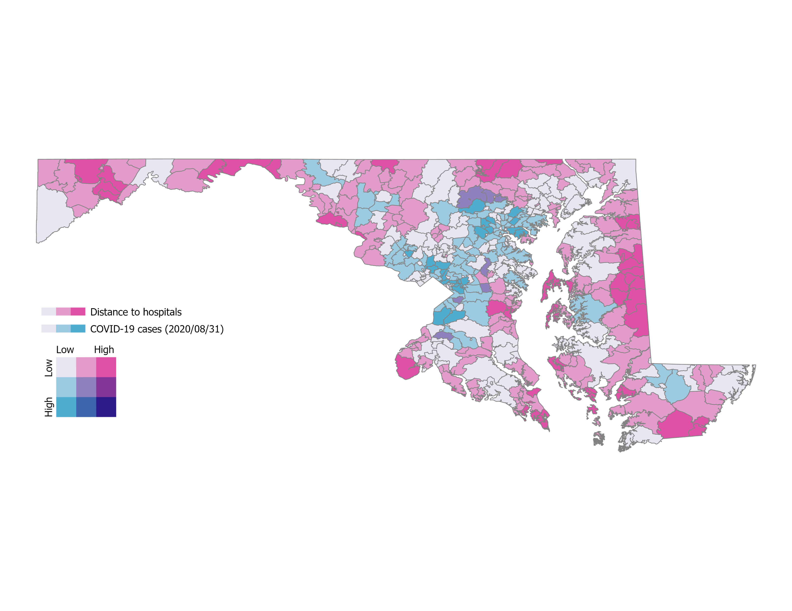
Notes:
Distance to hospitals: representing hospital accessibility
Fortunately, there is no high-high (long distance to hospital and high case number)

Slide 13
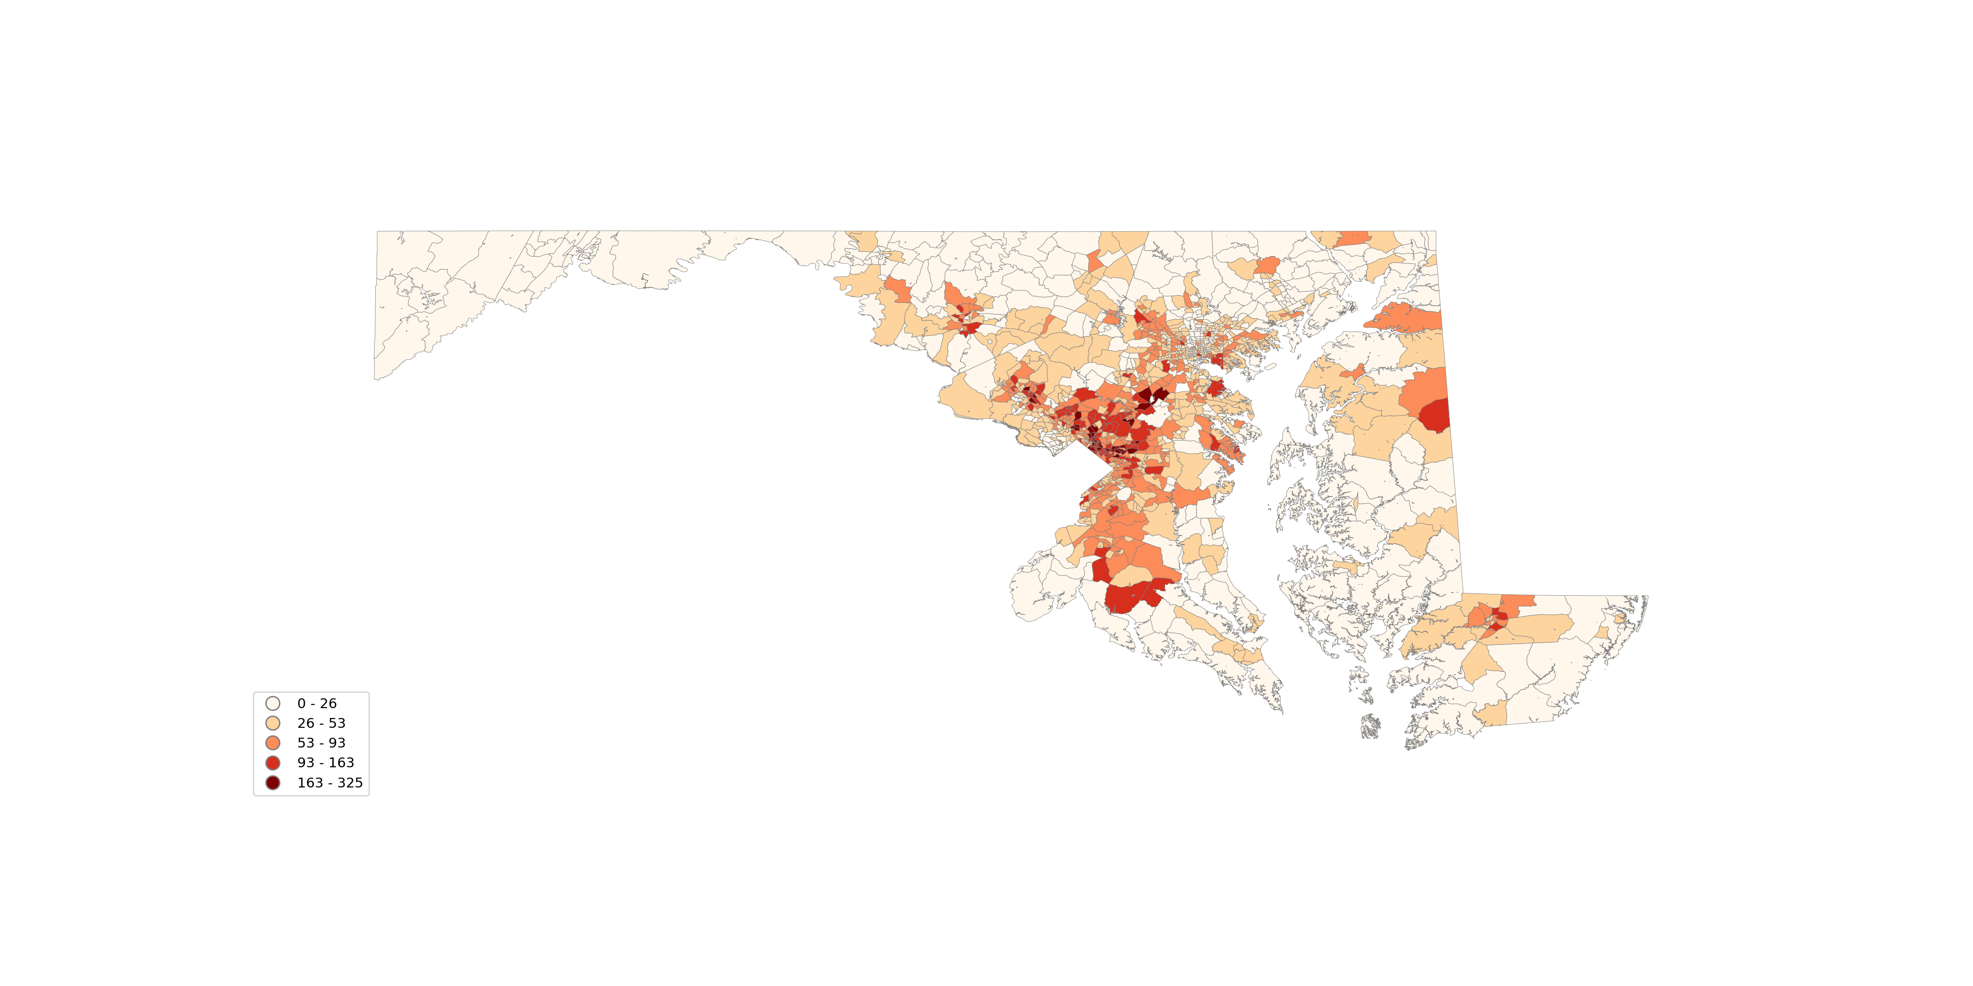
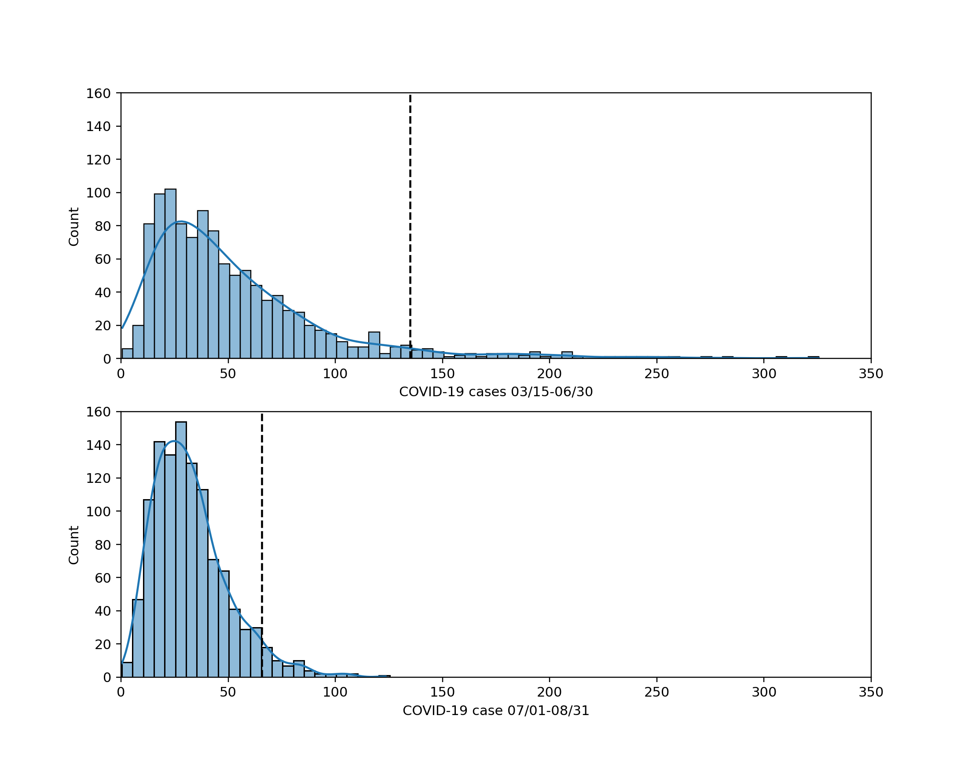
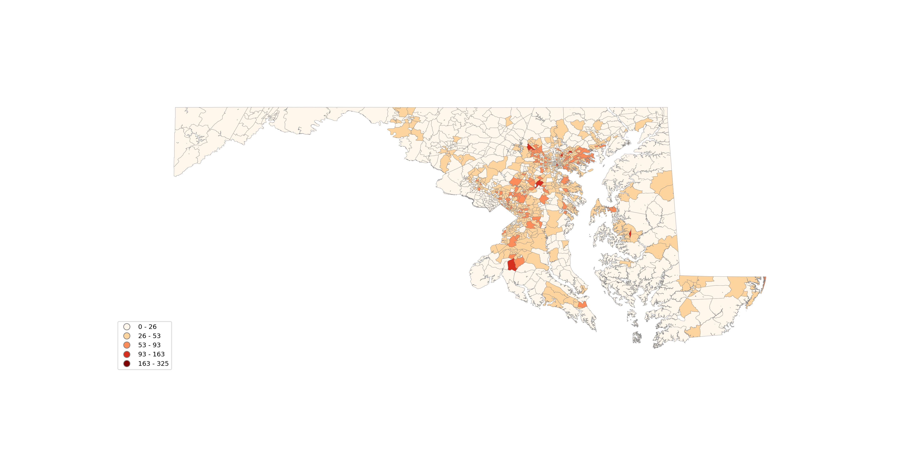
4.2. Hotspot analysis
New COVID-19 positive cases 03/15 – 06/30
New COVID-19 positive cases 07/01 – 08/31
Notes:
Overall, the first period has more cases. The second period shows less cases and less hotspots

Slide 14
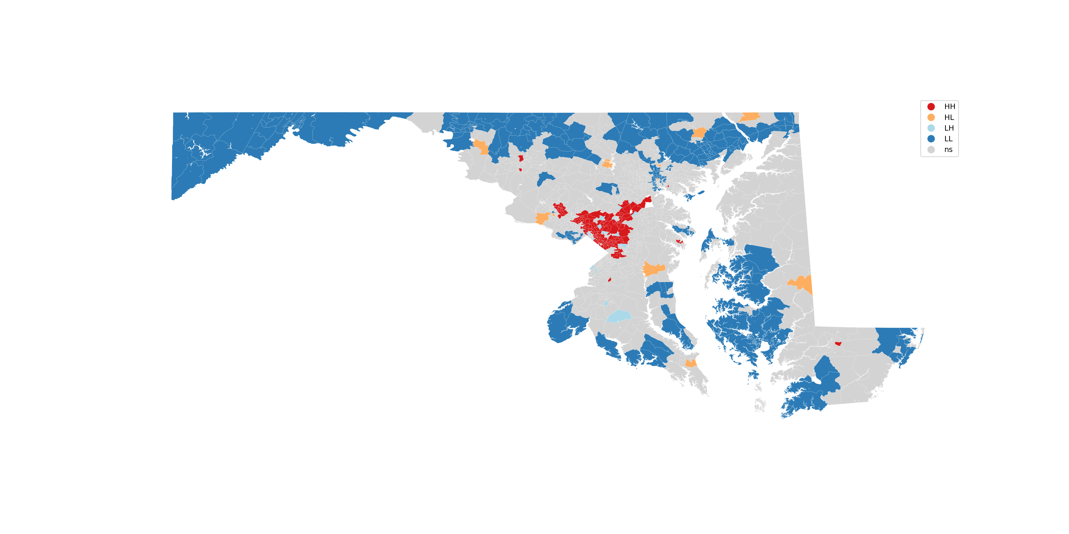
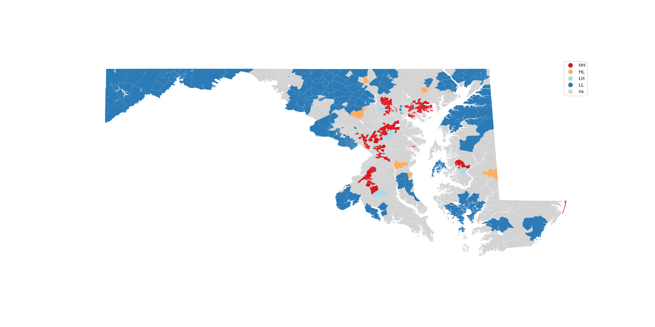
Hotspot analysis for new COVID-19 positive cases 03/15 – 06/30
Hotspot analysis for new COVID-19 positive cases 07/01 – 08/31
Notes:
Hotspots: clustered -> 5 separate locations

Slide 15
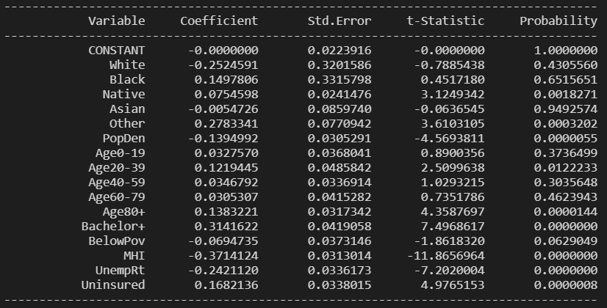
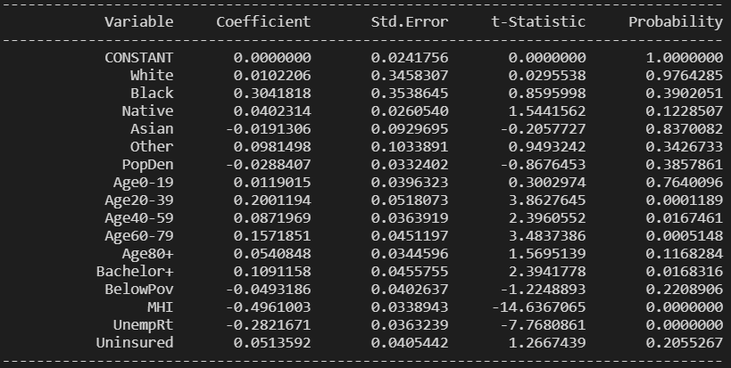
OLS for period 03/15 – 06/30
4.3. OLS and Random Forest
 |  | 03/15 – 06/30 | 07/01 – 08/31
R2 |  | 0.4715 | 0.3840
Adjusted R2 |  | 0.4635 | 0.3746
Top Variables | 1 | MHI (-) | MHI (-)
 | 2 | Bachelor (+) | Unemployment (-)
 | 3 | Other (+) | Age 20-39 (+)
 | 4 | Unemployment (-) | Age 60-79 (+)
 | 5 | Uninsured (+) | Bachelor (+)
OLS for period 07/01 – 08/31
Notes:
Many p-values are not significant

Slide 16
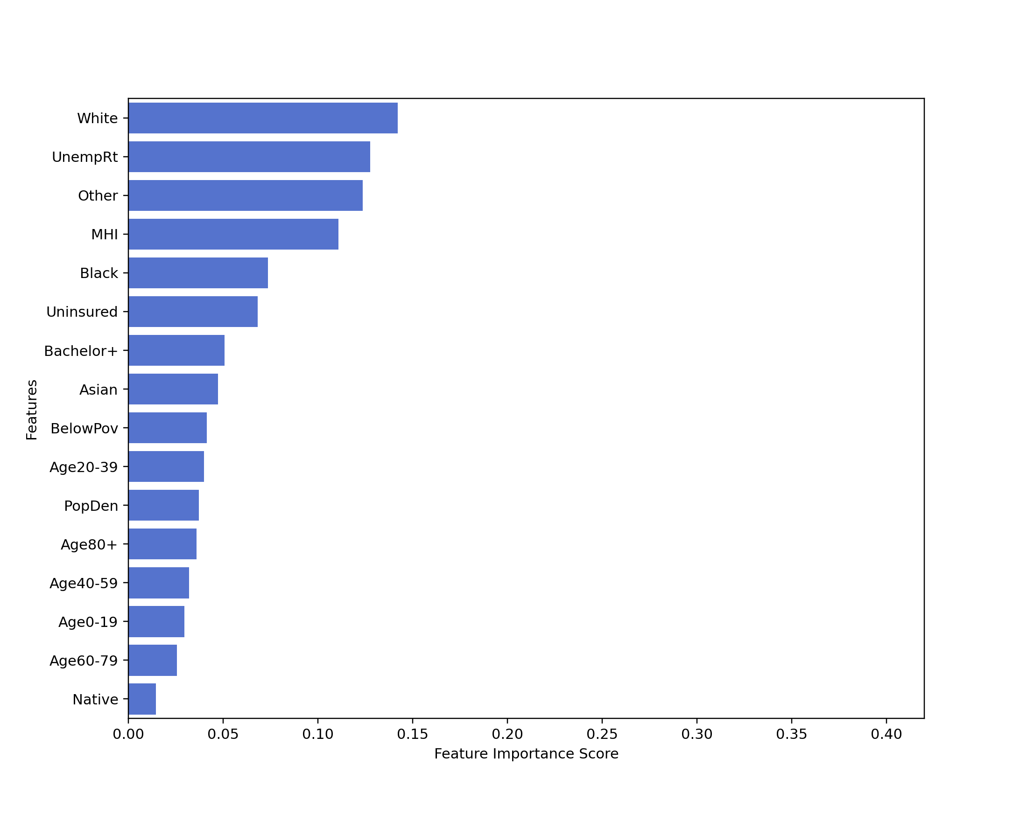
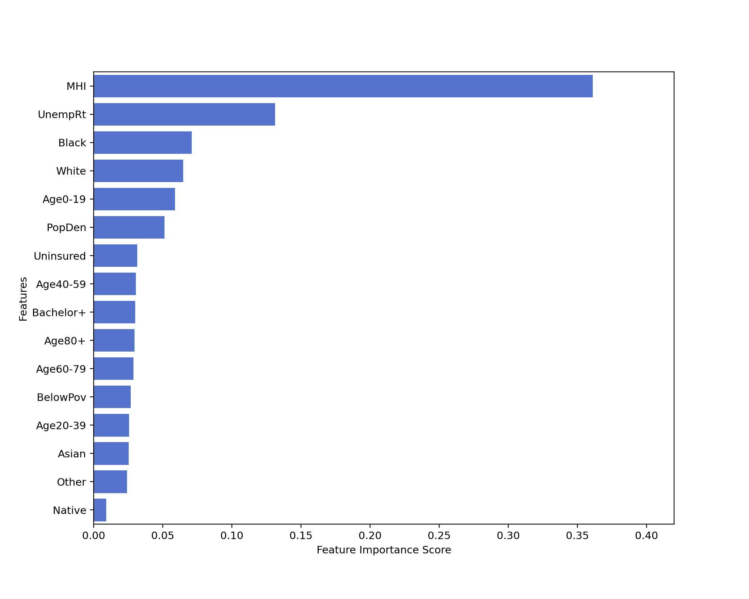
 |  | 03/15 – 06/30 | 07/01 – 08/31
R2 |  | 0.4586 | 0.3893
RMSE |  | 21.71 | 10.17
MAE |  | 15.81 | 8.01
Top Variables | 1 | White | MHI
 | 2 | Unemployment | Unemployment
 | 3 | Other | Black
 | 4 | MHI | White
 | 5 | Black | Age 0-19
Period 03/15 – 06/30
Period 07/01 – 08/31
Notes:
R-squared: 0.7703, 0.4586 RMSE: 13.12, 21.71 MAE: 9.65, 15.81
R-squared: 0.8206, 0.3893 RMSE: 6.00, 10.17 MAE: 4.48, 8.01
Both top: median household income, white, unemployment rate, black, uninsured
Going down: other
Going up: 0-19
MHI on the second time period

Slide 17
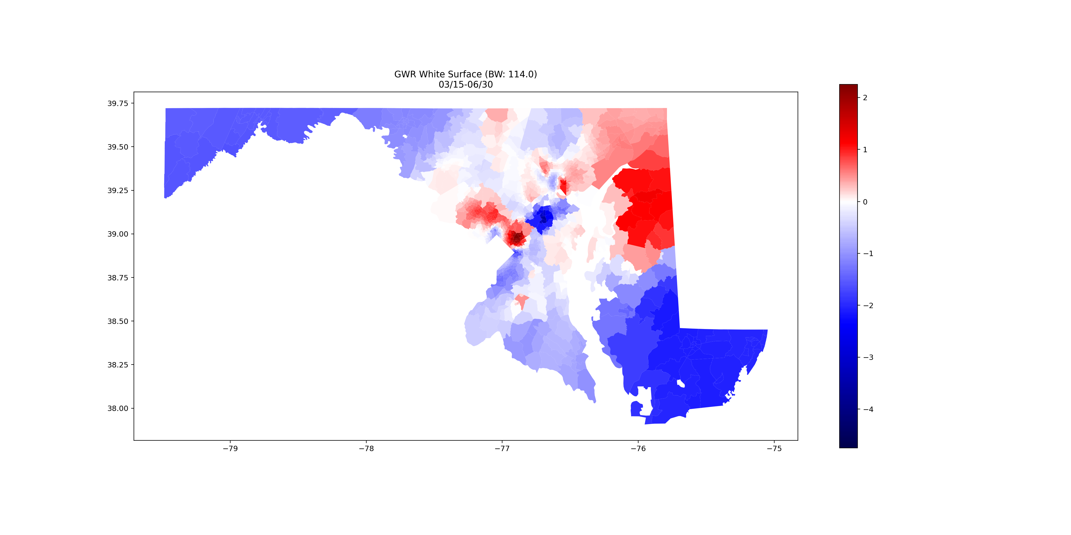
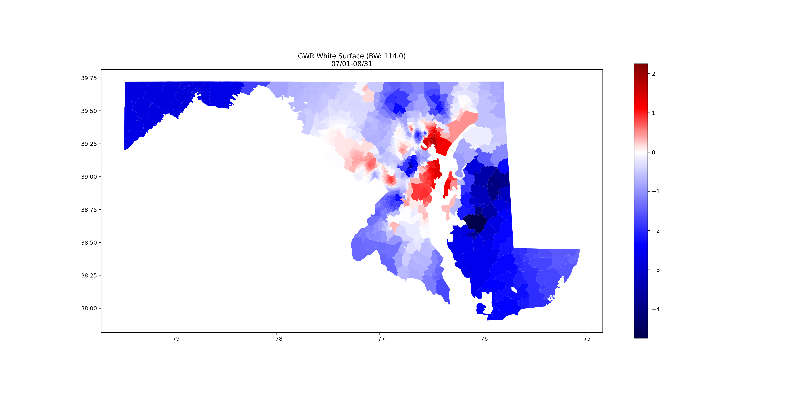
4.4. GWR
6 variables: White, unemployment rate, Other, median household income, Black, age 0-19
 | 03/15 – 06/30 | 07/01 – 08/31
R2 | 0.7323 | 0.6870
AIC | 2496.21 | 2745.86

Slide 18
Discussion and conclusion
There were 2 waves, and the third wave has arrived. Prince George’s county, Montgomery county, and Baltimore area have the most cases.
Cases were clustered near DC in the first time period, and then spread to 5 clusters.
Some variables that all ranked top in these models: White, Black, Other, median household income, unemployment rate, bachelor degree or higher, etc., which meets our expectations.
Among the 3 regression models (OLS, Random Forest, and GWR), GWR has the best model performance (R2=73.23% and 68.70%). Health officials may take the surface maps as references.
The Random Forest model overfitting has not been improved. Further studies on machine learning overfitting solutions are necessary.
The results of regionalization are unsatisfying due to unknown reason. Further studies are required.

Slide 19
Thanks
Q&A

